Slide 1
1. LATIHAN BOUNDARY VALUE ANALYSIS (BVA) TECHNIQUE
Sistem akan menterjemahkan markah yang diperolehi pelajar (dalam bentuk integer) kepada gred seperti berikut:
70 hingga 100 - ‘A’
50 hingga 69 - ‘B’
30 hingga 49 - ‘C’
0 hingga 29 - ‘D’
Sekiranya input yang tidak sah (invalid) dimasukkan, sistem akan memaparkan mesej “Ralat, input tidak sah”
Feature Set (FS)1 – generate_grading function
Apakah test condition, test coverage dan test case bagi spesifikasi keperluan di atas menggunakan three-value boundary testing with minimum test case?
Nota : Nilai terkecil bagi markah adalah 0.5
0
30
D
C
B
A
Invalid
0
Valid
30
Valid
50
Valid
70
Valid
100
Invalid
three-value boundary testing

Slide 2
1. LATIHAN BOUNDARY VALUE ANALYSIS (BVA) TECHNIQUE
D
C
B
A
Invalid
0
Valid
30
Valid
50
Valid
70
Valid
100
Invalid
EQUIVALENCE PARTITION | 0≤marks≤29 | 30≤marks≤49 | 50≤marks≤69 | 70≤marks≤100 | marks<0 | marks>100
TEST CONDITION
TEST COVERAGE
TEST CASE
OUTPUT | D | C | B | A | Ralat, input tidak sah | Ralat, input tidak sah
Each boundary is a test condition
Three value for each boundary
One TC can fulfil more than one TCV which is similar

Slide 3
2. LATIHAN COMBINATORIAL TEST DESIGN TECHNIQUES
Travel preference
Destination
Domestic International
Apakah test condition, test coverage dan test case bagi spesifikasi berikut menggunakan all combination testing?
Class
First Class Business Economy
Seat
Aisle Window
SUBMIT
CANCEL
Booking accepted
Feature Set (FS)1 – travel_preference function

Slide 4
2. LATIHAN COMBINATORIAL TEST DESIGN TECHNIQUES
Each P-V is a test condition
Identify test coverage using unique combinations of P-V pairs, made up of one P-V pair for each test item parameter
TCN1 | Destination – Domestic
TCV1 | Destination – Domestic Class – First Class Seat - Aisle

Slide 5
2. LATIHAN COMBINATORIAL TEST DESIGN TECHNIQUES
TEST CASE | INPUT |  |  | EXPECTED RESULT | TEST COVERAGE ITEM
TC1 | Domestic | First Class | Aisle | Booking Accepted | TCV1
Identify TC for each test coverage

Slide 6
3. LATIHAN DECISION TABLE TEST DESIGN TECHNIQUES
The check out function for MyShop application will check for membership status, total purchase (initially inclusive with delivery fee) and payment type. If the customer is a member, he/she will get 10% discount from total purchased item (excluding delivery fee). If the customer total purchase exceed RM 100 , he or she will get free delivery and free gift.
The total purchase will be re-calculated automatically if customer entitled for member’s discount or exemption of delivery fee. If customer select for COD, the item will be delivered immediately after checkout. Else, customer will be directed to payment gateway.
Item | Stainless steel shoe rack
Quantity
Delivery fee | RM 8.00
Price | RM 59.00
Member ID
 | - RM 5.90 (10% discount for member)
Payment type | Online COD
Total | RM 61.10
1
S3289
Apakah test condition, test coverage dan test case bagi spesifikasi di atas menggunakan decision table testing?
CHECKOUT
Feature Set (FS)1 – checkout function

Slide 7
3. LATIHAN DECISION TABLE TEST DESIGN TECHNIQUES
INPUT/CONDITION
OUTPUT/ACTION
Identify test condition
INPUT/CONDITION
OUTPUT/ACTION
Identify test coverage (each decision rule)

Slide 8
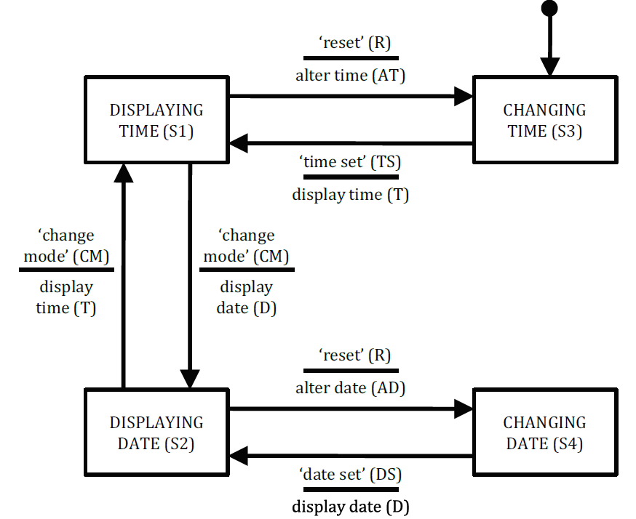
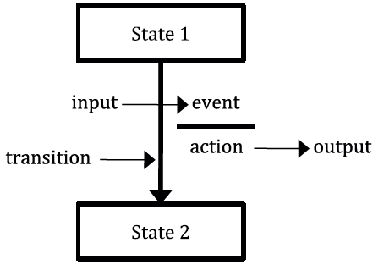
4. LATIHAN STATE TRANSITION TEST DESIGN TECHNIQUES
Apakah test condition, test coverage dan test case bagi state transition (all-transition) diagram berikut ?
 | Input 1 | Input 2 | etc
Start State 1 | Entry A | Entry B | etc
Start State 1 | Entry C | Entry D | etc
etc | etc | etc | etc
Generic state model
State table
Entry [ ] = Finish state/Output or Action for
the given start state or input
Feature Set (FS)1 – manage_display_changes

Slide 9
4. LATIHAN STATE TRANSITION TEST DESIGN TECHNIQUES
 | CM | R | TS | DS
S1
S2
S3
S4
Identify test coverage for all transition
Test Case
Start State
Input
Expected Output
Finish State
Test Coverage
Identify test case for each test coverage

