Slide 1
1. LATIHAN BOUNDARY VALUE ANALYSIS (BVA) TECHNIQUE
Sistem akan menterjemahkan markah yang diperolehi pelajar (dalam bentuk integer) kepada gred seperti berikut:
70 hingga 100 - ‘A’
50 hingga 69 - ‘B’
30 hingga 49 - ‘C’
0 hingga 29 - ‘D’
Sekiranya input yang tidak sah (invalid) dimasukkan, sistem akan memaparkan mesej “Ralat, input tidak sah”
Feature Set (FS)1 – generate_grading function
Apakah test condition, test coverage dan test case bagi spesifikasi keperluan di atas menggunakan three-value boundary testing with minimum test case?
Nota : Nilai terkecil bagi markah adalah 0.5
0
30
D
C
B
A
Invalid
0
Valid
30
Valid
50
Valid
70
Valid
100
Invalid
three-value boundary testing

Slide 2
1. LATIHAN BOUNDARY VALUE ANALYSIS (BVA) TECHNIQUE
D
C
B
A
Invalid
0
Valid
30
Valid
50
Valid
70
Valid
100
Invalid
EQUIVALENCE PARTITION | 0≤marks≤29 | 30≤marks≤49 | 50≤marks≤69 | 70≤marks≤100 | marks<0 | marks>100
TEST CONDITION
TEST COVERAGE
TEST CASE
OUTPUT | D | C | B | A | Ralat, input tidak sah | Ralat, input tidak sah
Each boundary is a test condition
Three value for each boundary
One TC can fulfil more than one TCV which is similar

Slide 3
JAWAPAN BOUNDARY VALUE ANALYSIS (BVA) TECHNIQUE
D
C
B
A
Invalid
0
Valid
30
Valid
50
Valid
70
Valid
100
Invalid
Each boundary is a test condition
EQUIVALENCE PARTITION | 0≤marks≤29 | 30≤marks≤49 | 50≤marks≤69 | 70≤marks≤100 | marks<0 | marks>100
TEST CONDITION | TCN1 mark = 0 TCN2 mark = 29 | TCN3 mark = 30 TCN4 mark = 49 | TCN5 mark = 50 TCN6 mark = 69 | TCN7 mark = 70 TCN8 mark = 100 | TCN9 mark = -0.5 | TCN10 mark = 100.5
TEST COVERAGE | TCV1 mark = - 0.5 TCV2 mark = 0 TCV3 mark = 0.5 TCV4 mark = 28.5 TCV5 mark = 29 TCV6 mark = 29.5 | TCV7 mark = 29.5 TCV8 mark = 30 TCV9 mark = 30.5 TCV19 mark = 48.5 TCV11 mark = 49 TCV12 mark = 49.5 | TCV13 mark = 49.5 TCV14 mark = 50 TCV15 mark = 50.5 TCV16 mark = 68.5 TCV17 mark = 69 TCV18 mark = 69.5 | TCV19 mark = 69.5 TCV20 mark = 70 TCV21 mark = 70.5 TCV22 mark = 99.5 TCV23 mark = 100 TCV24 mark = 100.5 | TCV25 mark = - 0.5 TCV26 mark = 0 TCV27 mark = 0.5 | TCV28 mark = 99.5 TCV29 mark = 100 TCV30 mark = 100.5
TEST CASE | TC2 for TCV2 & TCV26 TC3 for TCV3 & TCV27 TC4 for TCV4 TC5 for TCV5 TC6 for TCV6 & TCV7 | TC7 for TCV8 TC8 for TCV9 TC9 for TCV10 TC10 for TCV11 TC11 for TCV12 & TCV13 | TC12 for TCV14 TC13 for TCV15 TC14 for TCV16 TC15 for TCV17 TC16 for TCV18 & TCV19 | TC17 for TCV20 TC18 for TCV21 TC19 for TCV22 & TCV28 TC20 for TCV23 & TCV29 | TC1 for TCV1 & TCV25 | TC21 for TCV24 & TCV30
OUTPUT | D | C | B | A | Ralat, input tidak sah | Ralat, input tidak sah
Three value for each boundary
One TC can fulfil more than one TCV which is similar

Slide 4
2. LATIHAN COMBINATORIAL TEST DESIGN TECHNIQUES
Travel preference
Destination
Domestic International
Apakah test condition, test coverage dan test case bagi spesifikasi berikut menggunakan all combination testing?
Class
First Class Business Economy
Seat
Aisle Window
SUBMIT
CANCEL
Booking accepted
Feature Set (FS)1 – travel_preference function

Slide 5
2. LATIHAN COMBINATORIAL TEST DESIGN TECHNIQUES
Each P-V is a test condition
Identify test coverage using unique combinations of P-V pairs, made up of one P-V pair for each test item parameter
TCN1 | Destination – Domestic
TCN2 | Destination – International
TCN3 | Class – First Class
TCN4 | Class – Business
TCN5 | Class – Economy
TCN6 | Seat - Aisle
TCN7 | Seat - Window
TCV1 | Destination – Domestic Class – First Class Seat - Aisle
TCV2 | Destination – Domestic Class – Business Seat - Aisle
TCV3 | Destination – Domestic Class – Economy Seat - Aisle
TCV4 | Destination – Domestic Class – First Class Seat - Window
TCV5 | Destination – Domestic Class – Business Seat - Window
TCV6 | Destination – Domestic Class – Economy Seat - Window
TCV7 | Destination – International Class – First Class Seat - Aisle
TCV8 | Destination – International Class – Business Seat - Aisle
TCV9 | Destination – International Class – Economy Seat - Aisle
TCV10 | Destination – International Class – First Class Seat - Window
TCV11 | Destination – International Class – Business Seat - Window
TCV12 | Destination – International Class – Economy Seat - Window

Slide 6
2. LATIHAN COMBINATORIAL TEST DESIGN TECHNIQUES
TEST CASE | INPUT |  |  | EXPECTED RESULT | TEST COVERAGE ITEM
TC1 | Domestic | First Class | Aisle | Booking Accepted | TCV1
TC2 | Domestic | Business | Aisle | Booking Accepted | TCV2
TC3 | Domestic | Economy | Aisle | Booking Accepted | TCV3
TC4 | Domestic | First Class | Window | Booking Accepted | TCV4
TC5 | Domestic | Business | Window | Booking Accepted | TCV5
TC6 | Domestic | Economy | Window | Booking Accepted | TCV6
TC7 | International | First Class | Aisle | Booking Accepted | TCV7
TC8 | International | Business | Aisle | Booking Accepted | TCV8
TC9 | International | Economy | Aisle | Booking Accepted | TCV9
TC10 | International | First Class | Window | Booking Accepted | TCV10
TC11 | International | Business | Window | Booking Accepted | TCV11
TC12 | International | Economy | Window | Booking Accepted | TCV12
Identify TC for each test coverage

Slide 7
3. LATIHAN DECISION TABLE TEST DESIGN TECHNIQUES
The check out function for MyShop application will check for membership status, total purchase (initially inclusive with delivery fee) and payment type. If the customer is a member, he/she will get 10% discount from total purchased item (excluding delivery fee). If the customer total purchase exceed RM 100 , he or she will get free delivery and free gift.
The total purchase will be re-calculated automatically if customer entitled for member’s discount or exemption of delivery fee. If customer select for COD, the item will be delivered immediately after checkout. Else, customer will be directed to payment gateway.
Item | Stainless steel shoe rack
Quantity
Delivery fee | RM 8.00
Price | RM 59.00
Member ID
 | - RM 5.90 (10% discount for member)
Payment type | Online COD
Total | RM 61.10
1
S3289
Apakah test condition, test coverage dan test case bagi spesifikasi di atas menggunakan decision table testing?
CHECKOUT
Feature Set (FS)1 – checkout function

Slide 8
3. LATIHAN DECISION TABLE TEST DESIGN TECHNIQUES
INPUT/CONDITION
OUTPUT/ACTION
Identify test condition
INPUT/CONDITION
OUTPUT/ACTION
Identify test coverage (each decision rule)

Slide 9
3. LATIHAN DECISION TABLE TEST DESIGN TECHNIQUES
 | TCV1 | TCV2 | TCV3 | TCV4 | TCV5 | TCV6 | TCV7 | TCV8
INPUT/CONDITION
Member | T | T | T | F | F | F | F | T
Total purchase > 100 | T | F | T | F | T | F | T | F
Online Payment | T | F | F | F | T | T | F | T
OUTPUT/ACTION
Re-calculate total | T | T | T | F | T | F | T | F
Deliver item | F | T | T | T | F | F | T | F
Free gift | T | N | T | F | T | F | T | F
 | TC1 | TC2 | TC3 | TC4 | TC5 | TC6 | TC7 | TC8
INPUT/CONDITION
Member | Yes | Yes | Yes | No | No | No | No | Yes
Total purchase > 100 | 120 | 85 | 105 | 56 | 109 | 30 | 125 | 49
Online Payment | Yes | No | No | No | Yes | Yes | No | Yes
OUTPUT/ACTION
Re-calculate total | Yes | Yes | Yes | No | Yes | No | Yes | Yes
Deliver item | No | Yes | Yes | Yes | No | No | Yes | No
Free gift | Yes | No | Yes | No | Yes | No | Yes | No

Slide 10
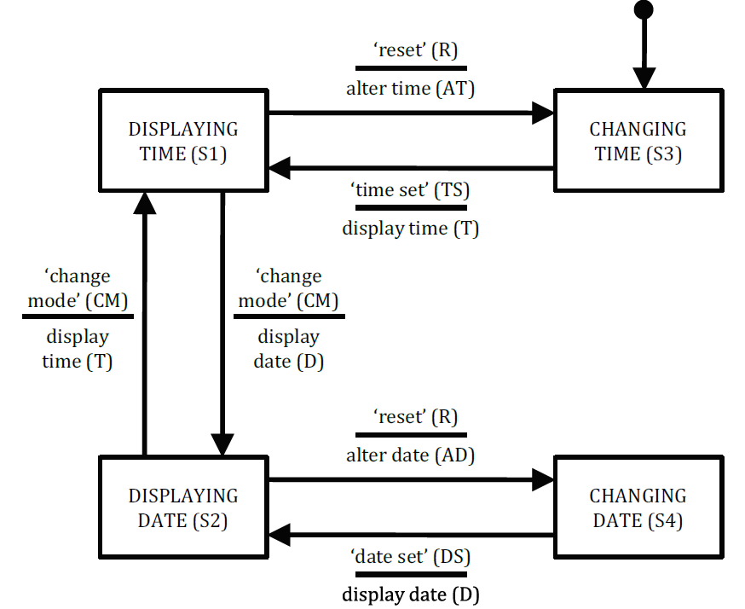
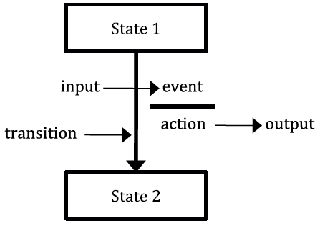
4. LATIHAN STATE TRANSITION TEST DESIGN TECHNIQUES
Apakah test condition, test coverage dan test case bagi state transition (all-transition) diagram berikut ?
 | Input 1 | Input 2 | etc
Start State 1 | Entry A | Entry B | etc
Start State 1 | Entry C | Entry D | etc
etc | etc | etc | etc
Generic state model
State table
Entry [ ] = Finish state/Output or Action for
the given start state or input
Feature Set (FS)1 – manage_display_changes

Slide 11
4. LATIHAN STATE TRANSITION TEST DESIGN TECHNIQUES
 | CM | R | TS | DS
S1
S2
S3
S4
Identify test coverage for all transition
Test Case
Start State
Input
Expected Output
Finish State
Test Coverage
Identify test case for each test coverage

Slide 12
JAWAPAN STATE TRANSITION TEST DESIGN TECHNIQUES
 | CM | R | TS | DS
S1 | S2/D (TCV1) | S3/AT (TCV2) | S1/- (TCV3) | S1/- (TCV4)
S2 | S1/T (TCV5) | S4/AD (TCV6) | S2/- (TCV7) | S2/- (TCV8)
S3 | S3/- (TCV9) | S3/- (TCV10) | S1/T (TCV1) | S3/- (TCV12)
S4 | S4/- (TCV13) | S4/- (TCV14) | S4/- (TCV15) | S2/D (TCV16)
Identify test coverage for all transition
Identify test case for each test coverage
Test Case | TC1 | TC2 | TC3 | TC4 | TC5 | TC6 | TC7 | TC8 | TC9 | TC10 | TC11 | TC12 | TC13 | TC14 | TC15 | TC16
Start State | S1 | S1 | S1 | S1 | S2 | S2 | S2 | S2 | S3 | S3 | S3 | S3 | S4 | S4 | S4 | S4
Input | CM | R | TS | DS | CM | R | TS | DS | CM | R | TS | DS | CM | R | TS | DS
Expected Output | D | AT | - | - | T | AD | - | - | - | - | T | - | - | - | - | D
Finish State | S2 | S3 | S1 | S1 | S1 | S4 | S2 | S2 | S3 | S3 | S1 | S3 | S4 | S4 | S4 | S2
Test Coverage | TCV1 | TCV2 | TCV3 | TCV4 | TCV5 | TCV6 | TCV7 | TCV8 | TCV9 | TCV10 | TCV11 | TCV12 | TCV13 | TCV14 | TCV15 | TCV16

