Slide 1
PERFORMANCE TEST REPORT
Cycle 1
<date>

Slide 2
CONTENTS
Objective
Scope
Test Deployment and Execution
Observations
Evaluation Criteria
Results
Findings and Recommendations
The Making of Performance Test

Slide 3
OBJECTIVE
What we want to do

Slide 4
Objective
To measure the performance of <system> under predefined transaction volumes from end-user perspective and test the system for responsiveness and reliability.

Slide 5
SCOPE
Our Agreement

Slide 6
Scope
Number of concurrent user <a number>
Response time less than or equal to < a number > second
Server performance monitor by <APM>
<a number> business transaction
(Description)
Run smoke test and load test
Run stress test for <a number> concurrent user

Slide 7
Host Resources
Application Server
CPU info
Memory info
Database Server
CPU info
Memory info

Slide 8
TEST DEPLOYMENT AND EXECUTION
How it works

Slide 9
Test Deployment and Execution

Slide 10
OBSERVATIONS
What we observe

Slide 11
Scripting
EXAMPLE
Scripting has been done on <execution date>
Script 1
Klik daftar
Isi Maklumat Pengguna
Hantar
Log masuk
Kemaskini profil
Sertai program
Log keluar

Slide 12
Scripting Process

Slide 13
Load Testing Preparation
<a number> laptop is used as Load Controller (Master)
<a number> laptop is used for Load Generator (Slave)
Preparation of Load generator (Install Apache JMeter, JDK 8, Disable VM Network, Disable Firewall and Antivirus)

Slide 14
On site Preparation

Slide 15
Data Preparation
Received test data contains of <a number> records
Database Administration cleanup data (Duplicate data cannot be used for registration)

Slide 16
EVALUATION CRITERIA
What we evaluate

Slide 17
Evaluation Criteria
Transaction Response Time using Application Performance Index (APDEX)
Failure Rate
Systems Performances
Errors and Exceptions

Slide 18
Application Performance Index (APDEX)
Apdex (Application Performance Index) is an open standard developed by an alliance of companies that defines a standardized method to report, benchmark, and track application performance.
Apdex is a numerical measure of user satisfaction with the performance of enterprise applications. It converts many measurements into one number on a uniform scale of 0-to-1 (0 = no users satisfied, 1 = all users satisfied)
The index is based on three zones of application responsiveness:
Satisfied: The user is fully productive. This represents the time value (T seconds) below which users are not impeded by application response time.
Tolerating: The user notices performance lagging within responses greater than T, but continues the process.
Frustrated: Performance with a response time greater than F seconds is unacceptable, and users may abandon the process.

Slide 19
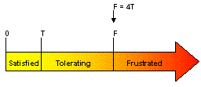
Application Performance Index (APDEX)
The Apdex formula is the number of satisfied samples plus half of the tolerating samples plus none of the frustrated samples, divided by all the samples:
For example, if there are 100 samples with a target time of 3 seconds, where 60 are below 3 seconds, 30 are between 3 and 12 seconds, and the remaining 10 are above 12 seconds, the Apdex is:

Slide 20
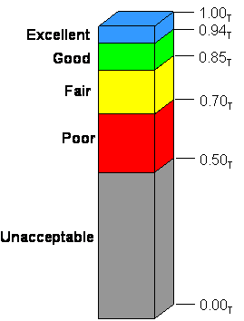
Application Performance Index (APDEX)
What is good APDEX value?
Apdex values fall between 0 and 1 where, 0 means that no users are satisfied and 1 indicates that all user samples were in the satisfied zone. Clearly, a higher number is better.
References: http://www.apdex.org/

Slide 21
RESULTS
1st Iteration - <a number>

Slide 22
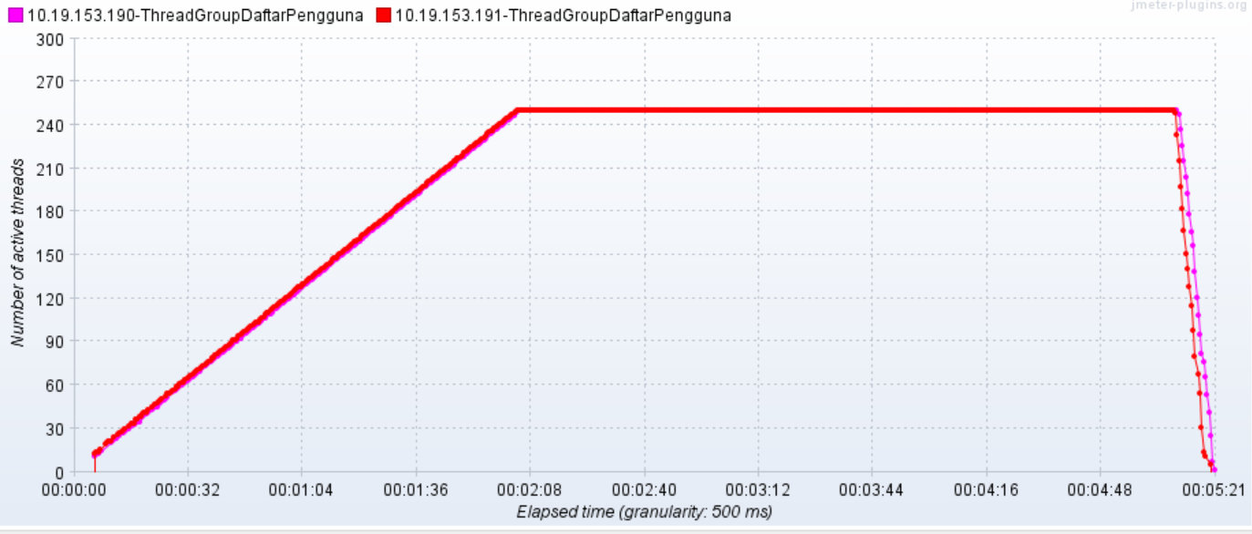
500 concurrent user

Slide 23
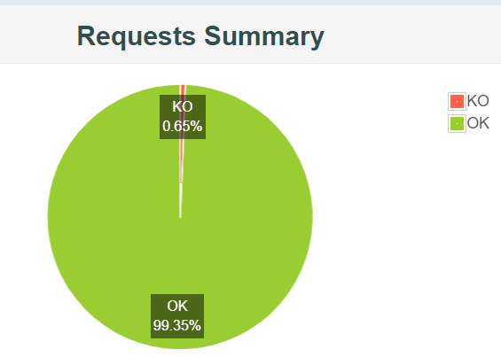
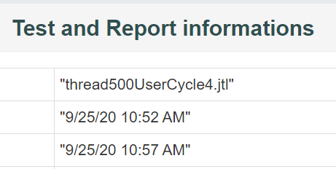
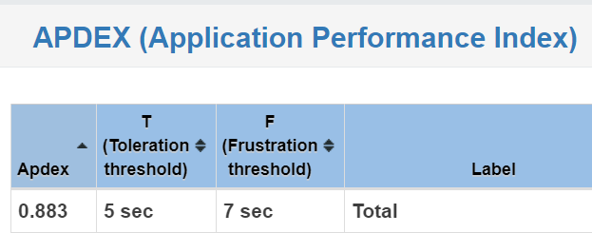
Result – 2nd Iteration – 500 concurrent user
EXAMPLE
APDEX : 0.883

Slide 24
FINDINGS AND RECOMMENDATIONS
What happen and How to improve

Slide 25
Findings
APDEX value for iteration 1 is <a number> . Baesd on APDEX value iteration 1 is <status> because it is below than 0.85.
Average Response Time is <a number> seconds
Main process affected response time are:

Slide 26
Recommendations
EXAMPLE
Tuning up configuration and application setting
Upgrade infra resources
Perform Cycle 2 performance test and repeat test for iteration 1, 2 and 3 after tuning up application and infra

Slide 27
OBSERVATION & RECOMMENDATION
<Application Performance Monitoring Tools>

Slide 28
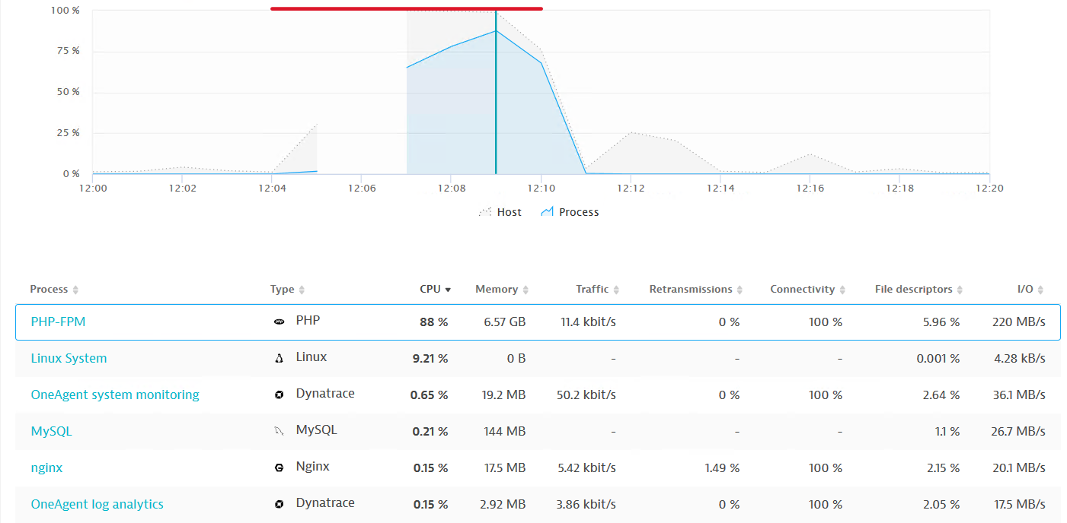
#1 Host Resources - CPU
EXAMPLE
99.7%

Slide 29
#1 Host Resources - Memory
EXAMPLE
99.7%

Slide 30
Recommendation
EXAMPLE
Review the capacity of the servers.
Separate the App and DB to easily identify and isolate the issues.

Slide 31
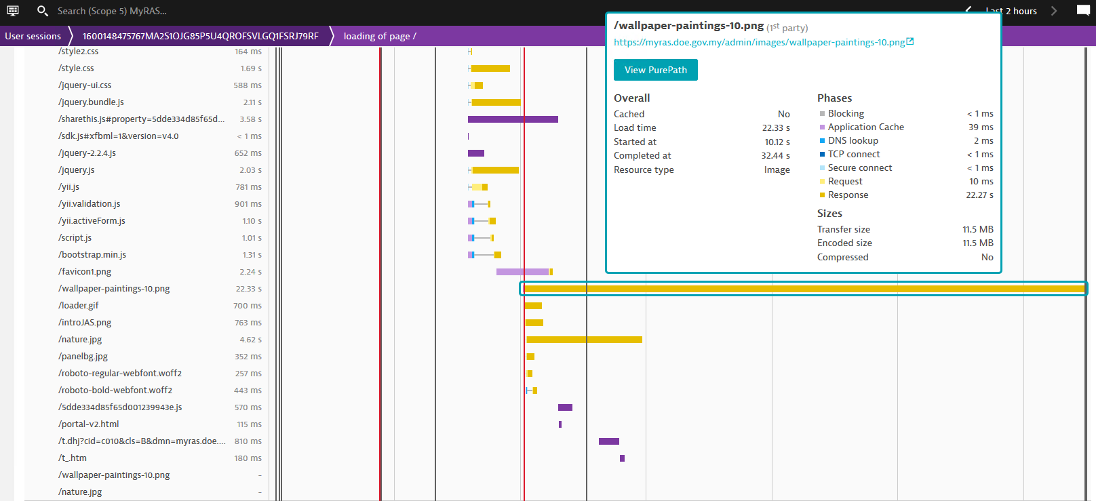
#2 Large Image File (Landing Page)
EXAMPLE

Slide 32
Recommendation
EXAMPLE
Resize and compress the images.
Text resources such as JavaScript, CSS and HTML can be compressed by enabling gzip.

Slide 33
#3 Expensive Database Statement
EXAMPLE

Slide 34
#3 Expensive Database Statement
EXAMPLE

Slide 35
Summary of Result (500)
EXAMPLE
Evaluation Criteria | Cycle 3 | Cycle 4
APDEX | 0.802 | 0.883
Average Response Time | 3.56 second | 2.64 second
Error rate | 0.96% | 0.65%
Infra utilization
1) Apps Server (CPU) | 84% | 70%
2) Apps Server (RAM) | 19.4% | 24.9%
3) DB Server (CPU) | 99% | 51%
4) DB Server (RAM) | 19.1% | 21.3%
Result | FAILED | PASS

Slide 36
Recommendation
EXAMPLE
Review and optimized the expensive database statement.
Database tuning and indexing.

Slide 37
THE MAKING OF PERFORMANCE TEST
Proof and documentation

Slide 38
Early Discussion

Slide 39
War Room/ Training Lab

Slide 40
Thank You.
my

